Slide 1
Team Simple
Neeraj Aggarwal, Samarth Keshari, Rishi Wadhwa

Slide 2
Our Project: Text Classification Competition
Goal = to build a model that can perform Sarcasm Detection on twitter data
Evaluation Target = the model should have F1 score greater than 0.723

Slide 3
Our Approach
Approach-1 = Traditional Machine Learning
Input Text Representation = Bag-of-Words (bi-gram)
Algorithms = Random Forest, Logistic Regression, SGD(SVM) & MLP
Approach-2 = Deep Learning
Input Text Representation = Pre-trained BERT tokenizer
Architecture = Convolutional Neural Networks

Slide 4
Results
Approach | Algorithm | Precision | Recall | F1
Deep Learning | Convolutional Neural Networks | 0.6227867590454196 | 0.8988888888888888 | 0.7357889949977261
Machine Learning | Random Forest Classifier | 0.6824825174825175 | 0.7265952491849093 | 0.7265952491849093

Slide 5
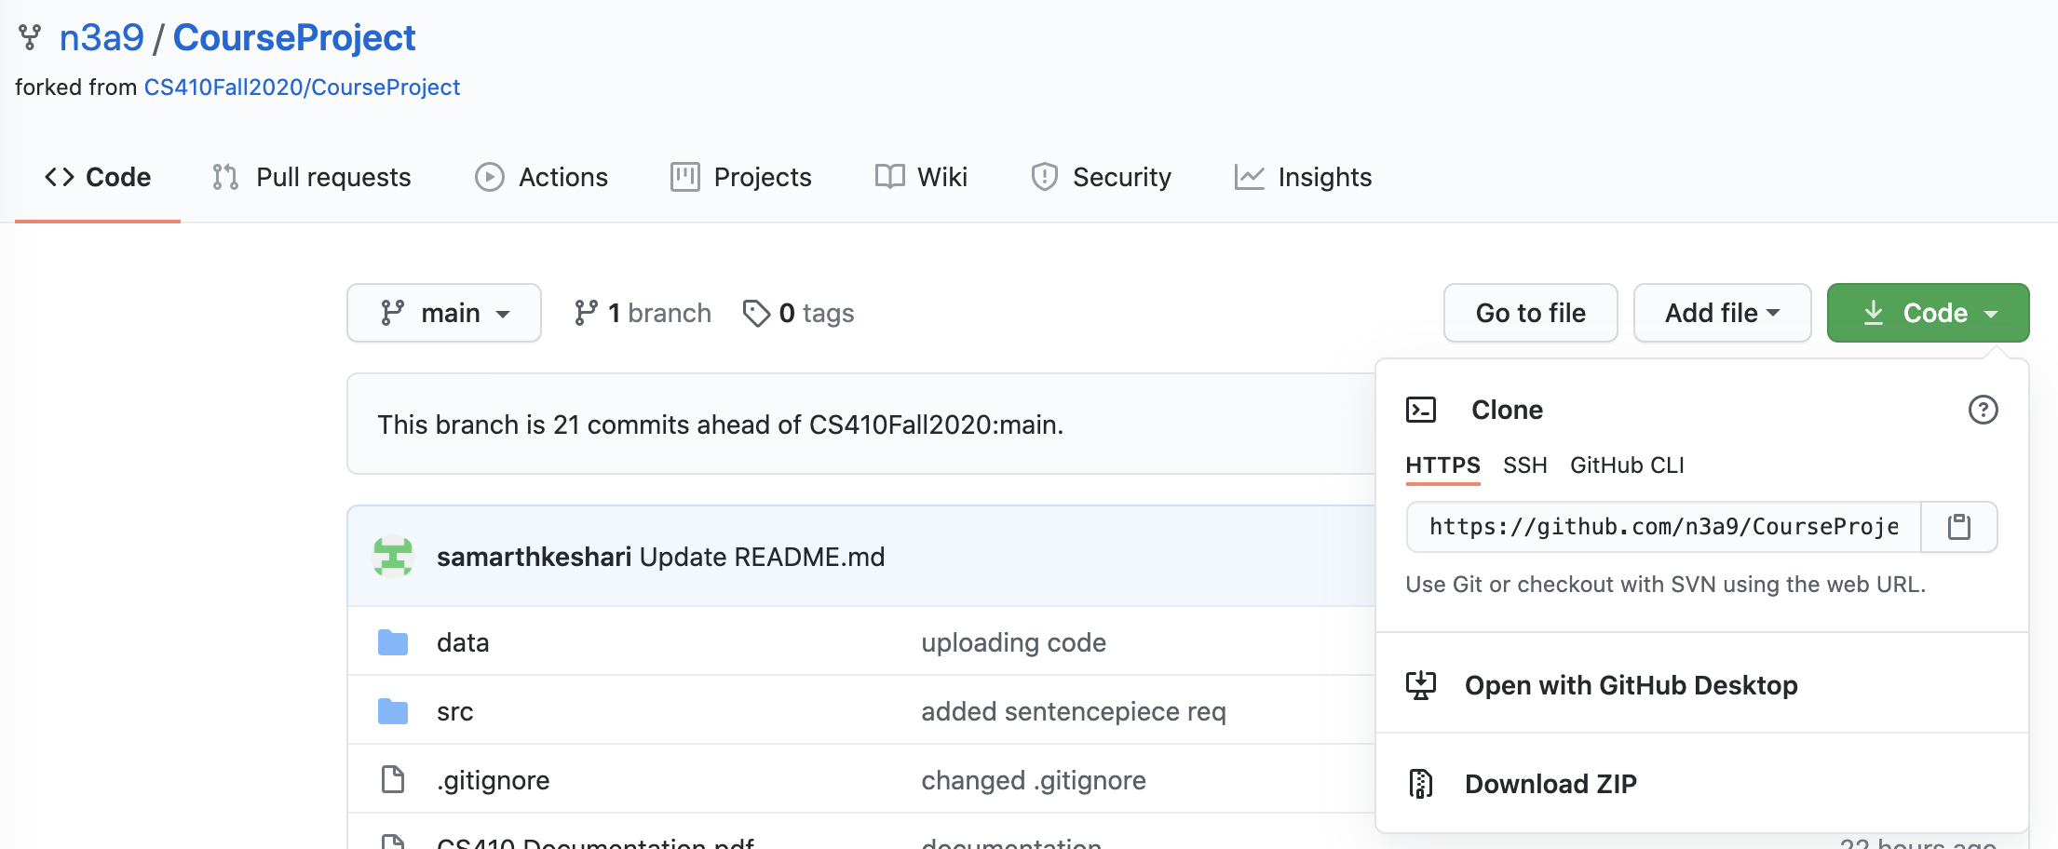
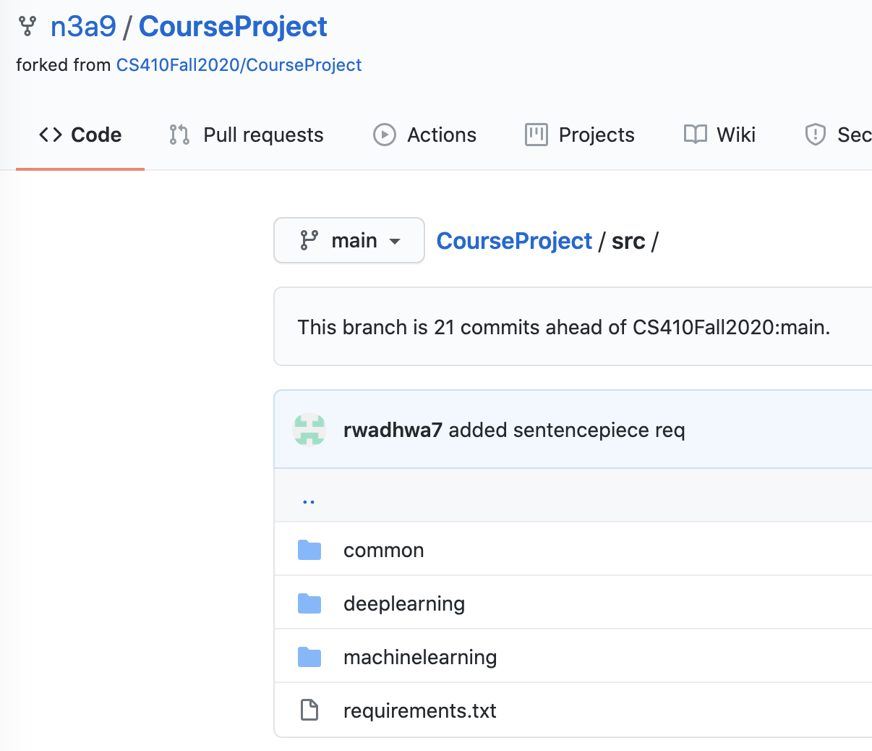
Installation
Python(version 3.7 - 3.8)
Visit https://github.com/n3a9/CourseProject
Download or Clone the Code
Required Packages(pip install)
emoji==0.6.0
pandas==1.1.3
nltk==3.5
tensorflow==2.3.1
numpy==1.18.5
Keras==2.4.3
scipy==1.5.2
demoji==0.3.0
bert-for-tf2==0.14.7
scikit_learn==0.23.2
* You can automatically install all of these packages by navigating into the project directory ‘./src’ and then running command pip install -r requirements.txt

Slide 6
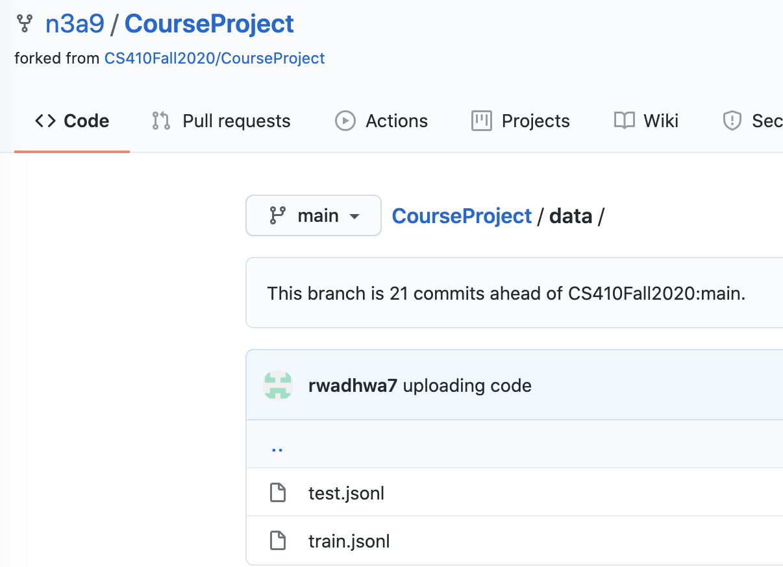

Code Repository Structure
Data in ‘data’ directory where we can find train and test files
Source Code in ‘src’ directory
Machine Learning code in ‘machinelearning’ directory - ‘./src/machinelearning’
Deep Learning in ‘deeplearning’ repository - ‘./src/deeplearning’

Slide 7
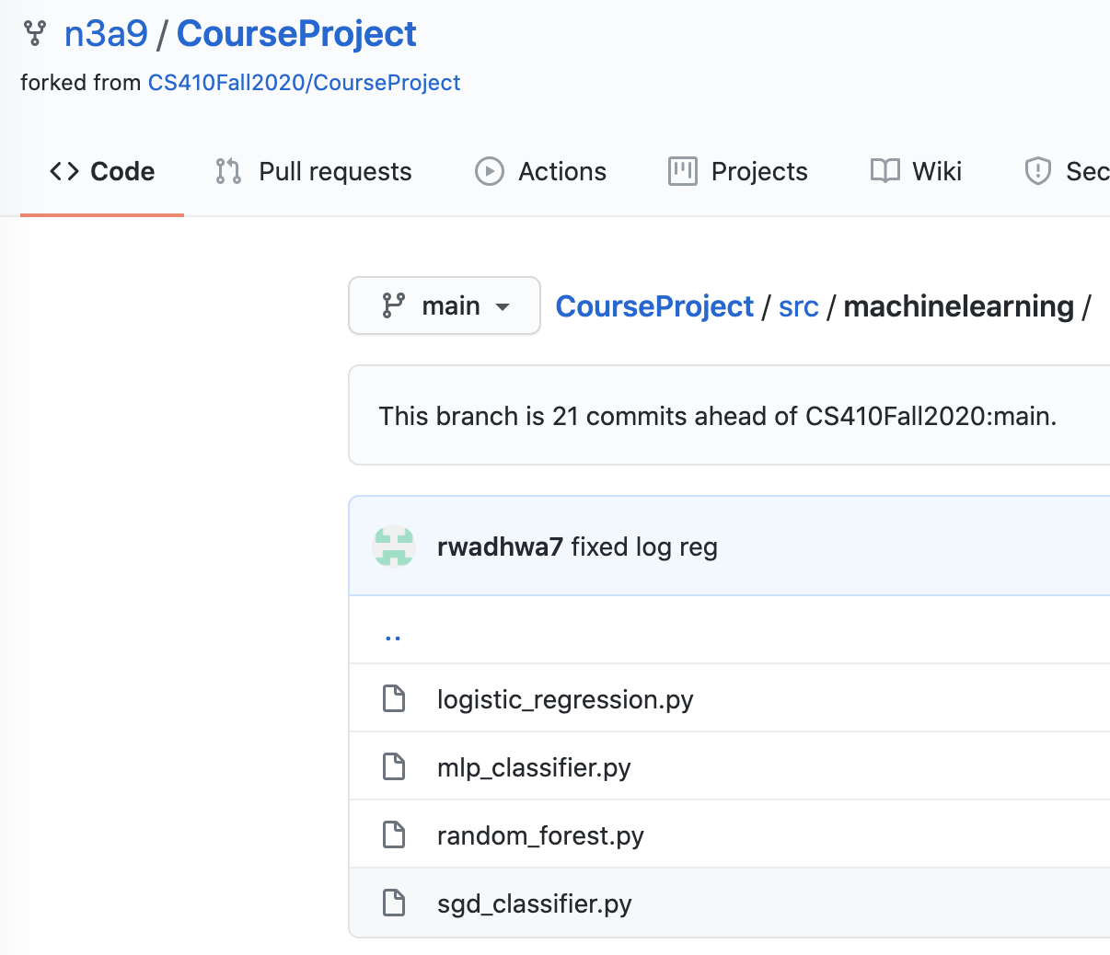
Usage - Machine Learning
There are 4 machine learning models that are available for usage:
- Random Forest Classifier `random_forest.py` (best result classifier)
- MLP Classifier `mlp_classifier.py`
- SGD(SVM) Classifier `sgd_classifier.py`
- Logistic Regression `logistic_regression.py`
To run the machine learning models, navigate to the machine learning directory - `./src/machinelearning` - and execute command`python [file.py]`. For example executing command ‘python random_forest.py’ in the terminal will run Random Forest Classifier.
It will generate an `answer.txt` in `./src/machinelearning`

Slide 8
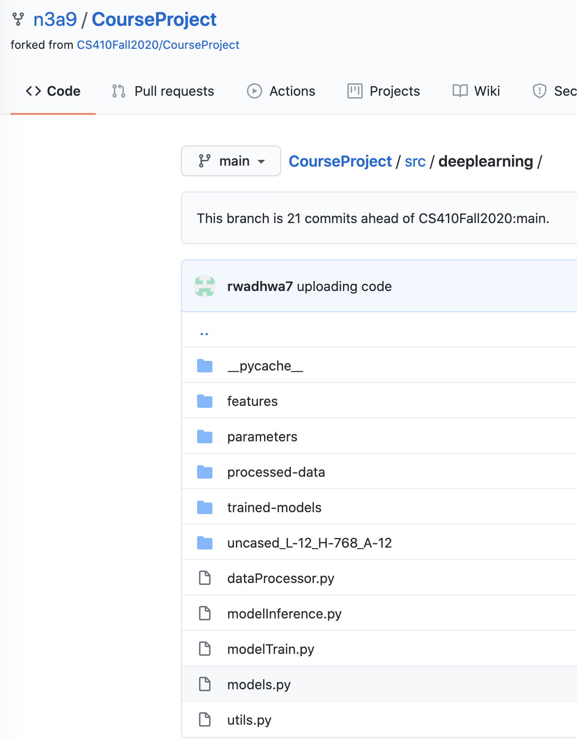
Usage - Deep Learning
There are 2 programs that are available for usage:
- Model Training `modelTrain.py`
- Model Inference `modelInference.py`
There is a list of parameters that are used to control the training and inference programs. These parameters can be adjusted to influence the behavior of the 2 programs.
*Refer to documentation to learn more about these parameters

Slide 9
Usage - Deep Learning(Training)
To run the model training, navigate to the deep learning directory - `./src/deeplearning` - and execute command`python modelTrain.py`
This will save the trained model weights as `cnn_model_weight.h5` in `./src/machinelearning/trained-models`
* Currently, by default any new trained model weights will not be saved. Also, caution should be taken that any new trained model weights, if saved can vary the final results

Slide 10
Usage - Deep Learning(Inference)
To run the model inference, navigate to the deep learning directory - `./src/deeplearning` - and execute command`python modelInference.py`
It will generate an `answer.txt` in `./src/deeplearning`

Slide 11
Thank You!!!
For any questions please contact
Neeraj Aggarwal (noa2@illinois.edu)
Samarth Keshari (keshari2@illinois.edu)
Rishi Wadhwa (rishiw2@illinois.edu)

